Slide 1
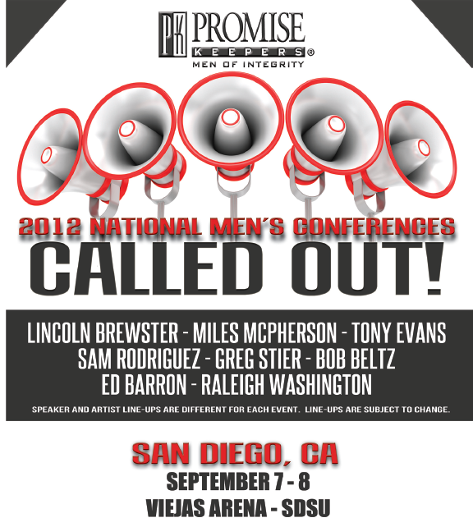
Grace Point Church Fall 2012 Men’s Retreat
Grace Point Church Fall 2012 Men’s Retreat
REGISTRATION $39
Sign up at: http://www.promisekeepers.org/events/san-diego-registration
Discount Code: 0912-GRPC
Bus will leave from Grace Point Church. Meet us here on Friday 5PM and Saturday morning at 7:30AM.
Invite friends, family, co-workers to focus on God’s call to men to follow, to lead, to serve
REGISTRATION $39
Sign up at: http://www.promisekeepers.org/events/san-diego-registration
Discount Code: 0912-GRPC
Bus will leave from Grace Point Church. Meet us here on Friday 5PM and Saturday morning at 7:30AM.
Invite friends, family, co-workers to focus on God’s call to men to follow, to lead, to serve

